Slide 1
Gender issues
in H2020 RIA proposals

Slide 2
H2020 and gender
Gender is addressed as a cross-cutting issue in order to rectify imbalances between women and men as far as the implementation of projects is concerned, and to integrate a gender dimension in the research and innovation content. http://ec.europa.eu/research/participants/docs/h2020-funding-guide/cross-cutting-issues/gender_en.htm
https://ec.europa.eu/programmes/horizon2020/sites/horizon2020/files/FactSheet_Gender_2.pdf
Objectives:
Gender balance in decision-making
Gender balance in research teams at all levels
Gender dimension in research and innovation (RIA) content

Slide 3
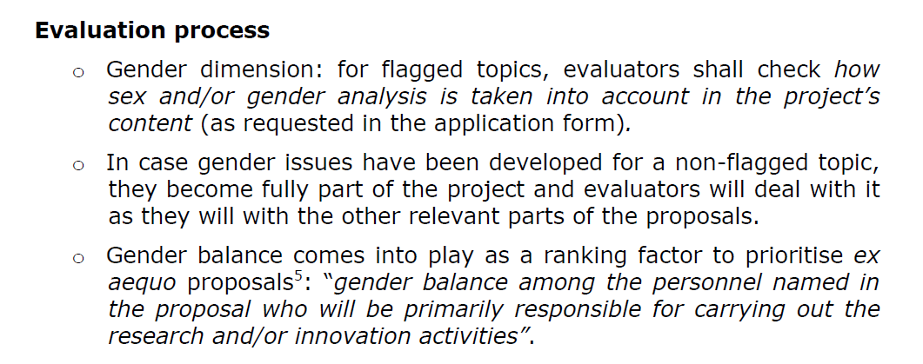
Role of gender in evaluation
gender-flagged topics :
http://ec.europa.eu/research/participants/portal/desktop/en/opportunities/h2020/ftags/gender.html#c,topics=flags/s/Gender/1/1&+callStatus/asc
(if this doesn’t work: participant portal search page, button for gender under cross cutting issues)

Slide 4
How to address in the proposal? (1)
Write something down! Explain if no gender effects.
1. gender in decision making & 2. gender balance:
3.2 Management structure & procedures
4.1. Participants
3. gender in content (both research & impact!)
1.3 Concept and approach
2.1. Expected impact
3.1a Work package descriptions

Slide 5
How to address in the proposal? (2)
1. gender in decision making & 2. gender balance
Clarify gender balance in daily management, different boards and among WP leaders
If skewed, explain why
Policies (all partners) for equal opportunities
Example: Leiden University charter Talent naar de Top & werkplan Diversiteit en inclusiviteit
Make someone responsible for monitoring gender balance during the project
Offer ‘gender training’ (university, external organisations)
university diversity officer: dr. Isabel Hoving

Slide 6
How to address in the proposal? (3)
3. sex/gender in content
Biological characteristics and social/cultural factors
Gendered innovations research design:
http://ec.europa.eu/research/science-society/gendered-innovations/index_en.cfm?pg=home
Effect on:
Research question
Research design: Indicate how the study design answer research questions both for males and females if the topic being studied occurs in both sexes/genders.
Data collection and analysis -> data management
Outreach and dissemination

Slide 7
Gender issues
Reviewers comments
None found!

